Slide 1


<Almahdi OUBIHI>
<14 February 2024>

Slide 2

Outline
Executive Summary
Introduction
Methodology
Results
Conclusion
Appendix

Slide 3
Executive Summary
First, we collected data using both web scraping and API.
After refining the data, we analyzed it extensively.
Using powerful visualization tools, we gained insight about SpaceX rocket launching success rate history.
Launching success rate depends on multitude of parameters most important of which are: payload mass, orbits and launch sites.

Slide 4
Introduction
As a new competitor in space rocket launching market, we need to analyze SpaceX first phase rocket launching history. Thus, we can determine in what case the first stage can be is reusable.
What parameters(orbit, payload mass, launch site) permit a higher reuse rate of 1st stage, and consequently reduce the launching cost ?

Slide 5

Section 1

Slide 6
Methodology
Executive Summary
Data collection methodology:
Describe How Data was collected
Perform data wrangling
Describe how data was processed
Perform exploratory data analysis (EDA) using visualization and SQL
Perform interactive visual analytics using Folium and Plotly Dash
Perform predictive analysis using classification models
How to build, tune, evaluate classification models

Slide 7
Data Collection
Describe how data sets were collected.
Data was collected in two ways: web scrapping, and SpaceX website API
You need to present your data collection process use key phrases and flowcharts

Slide 8
Data Collection – SpaceX API
Requests.json()
Pandas.Dataframe()
Dealing with missing values : mean()
We fetched REST API data using requests library and json() function.
We restructured data using pandas dataframe. And we addressed missing values.
https://github.com/Alma-Soul/Coursera.git

Slide 9
Data Collection - Scraping
Using requests get and beautiful soup, we scraped html tables.
https://github.com/Alma-Soul/Coursera.git
requests.get()
Beautiful soup object
Web scrap table using finad_all-)

Slide 10
Data Wrangling
We loaded the csv dataset into a pandas dataframe. Then using powerful panadas and NumPy's methods we Identifies missing values; we addressed them accordingly.
We created landing outcome labels’ class. To replace phrases by [0,1] values.
https://github.com/Alma-Soul/Coursera.git
Exploratory analysis
Dealing with missing values
Creating numerical labels instead of words

Slide 11
EDA with Data Visualization
Summarize what charts were plotted and why you used those charts
Add the GitHub URL of your completed EDA with data visualization notebook, as an external reference and peer-review purpose

Slide 12
EDA with SQL
Using bullet point format, summarize the SQL queries you performed
Add the GitHub URL of your completed EDA with SQL notebook, as an external reference and peer-review purpose

Slide 13
Build an Interactive Map with Folium
Summarize what map objects such as markers, circles, lines, etc. you created and added to a folium map
Explain why you added those objects
Add the GitHub URL of your completed interactive map with Folium map, as an external reference and peer-review purpose

Slide 14
Build a Dashboard with Plotly Dash
Summarize what plots/graphs and interactions you have added to a dashboard
Explain why you added those plots and interactions
Add the GitHub URL of your completed Plotly Dash lab, as an external reference and peer-review purpose

Slide 15
Predictive Analysis (Classification)
Summarize how you built, evaluated, improved, and found the best performing classification model
You need present your model development process using key phrases and flowchart
Add the GitHub URL of your completed predictive analysis lab, as an external reference and peer-review purpose

Slide 16
Results
Exploratory data analysis results
Interactive analytics demo in screenshots
Predictive analysis results

Slide 17

Section 2

Slide 18
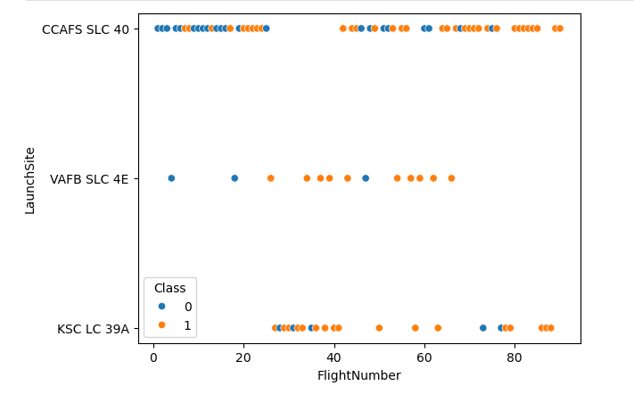
Flight Number vs. Launch Site
Higher flight numbers are more successful for all three launching sites.

Slide 19
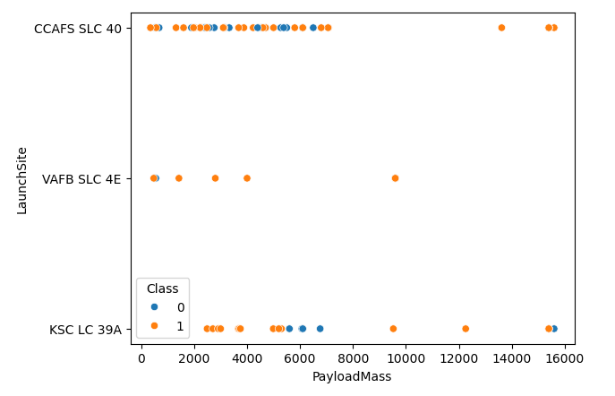
Payload vs. Launch Site
CCAFS site has higher success rate for heavy payloads.
There are no heavy payloads launched from VAFB site.

Slide 20
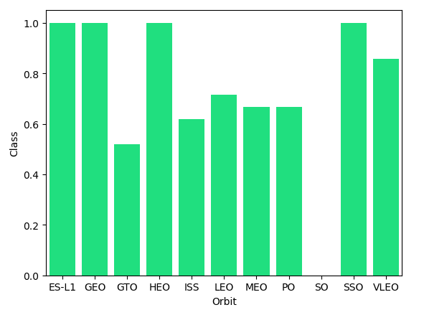
Success Rate vs. Orbit Type

Slide 21
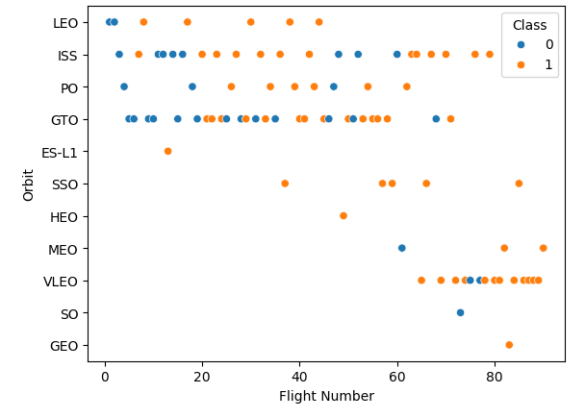
Success Rate vs. Orbit Type
The number of flight seems to be correlated with LEO orbit.
Meanwhile it doesn’t seem to be any relationship between these parameters for GTO and ISS.

Slide 22
Flight Number vs. Orbit Type
The number of flight seems to be correlated with LEO orbit.
Meanwhile it doesn’t seem to be any relationship between these parameters for GTO and ISS.

Slide 23
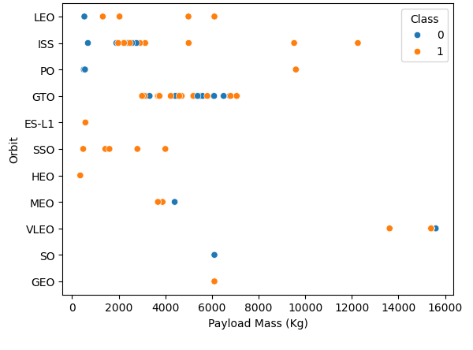
Payload vs. Orbit Type
LEO orbit shows a better landing success rate for

Slide 24
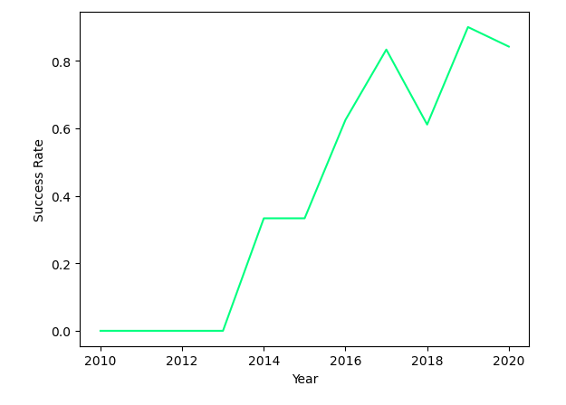
Launch Success Yearly Trend
Success rate increases over time.

Slide 25
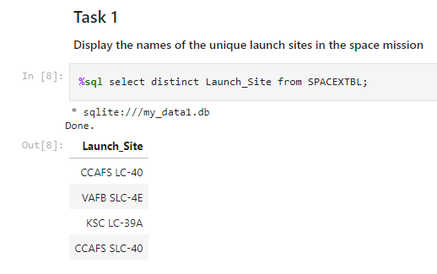
All Launch Site Names
Space missions use four launch sites as shown beside.
Keyword to use is “distinct”.

Slide 26
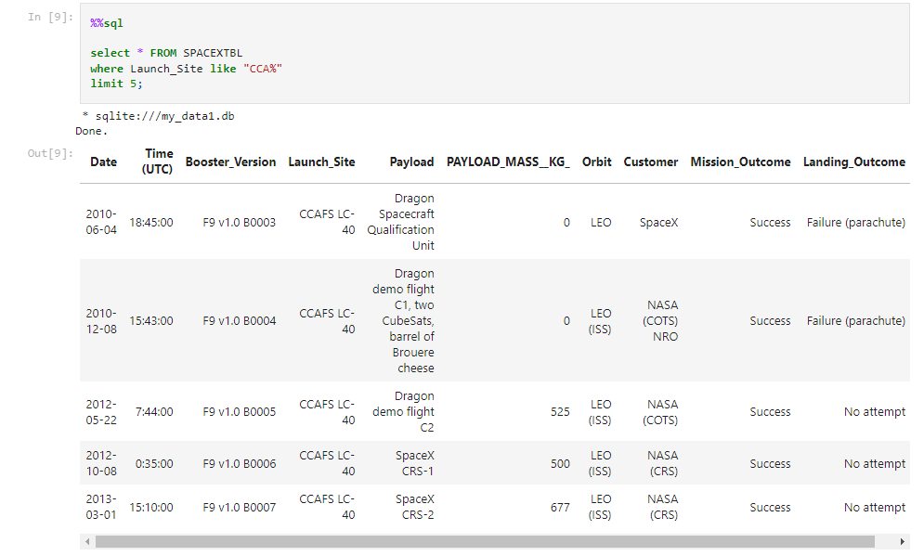
Launch Site Names Begin with 'CCA'
Using the key word “like” on column Launch_Site we substructed all sites whose names start with “CCA”
Key word “limit” is used to select first 5 rows.

Slide 27
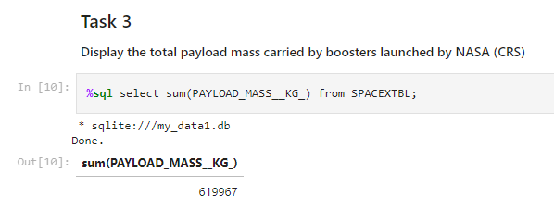
Total Payload Mass
Using key word sum on column PAYLOAD_MASS__KG_ we get total payload mass.

Slide 28
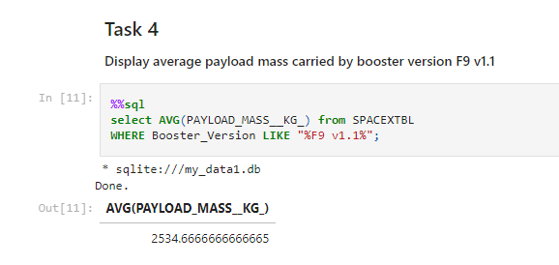
Average Payload Mass by F9 v1.1
AVG() to get average value.
“Like” to filter on F9 v1.1

Slide 29
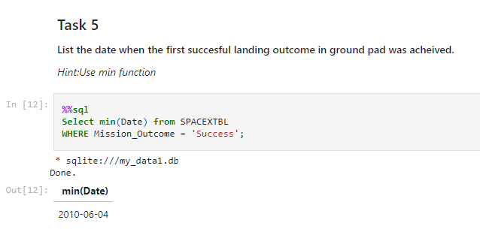
First Successful Ground Landing Date
The first successful landing wa 2010-06-04.
We used min() on column Date and a predicament with Mission_Outcome.

Slide 30
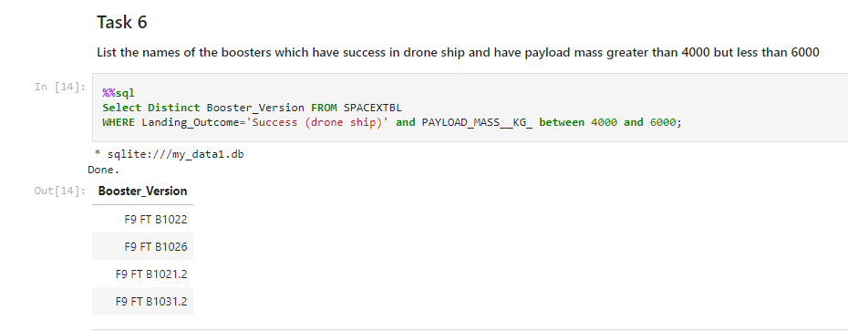
Successful Drone Ship Landing with Payload between 4000 and 6000
Two predicaments considered : successful drone ship Landing outcome and payload between 4000 and 6000.
Key word distinct() to eliminate duplicates.

Slide 31
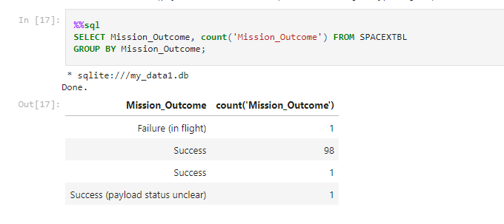
Total Number of Successful and Failure Mission Outcomes
Using count() on Mission_Outcome column, we get total numbers of Success and Failure.
As shown before us : we have 100 successful mission and only one failure.

Slide 32
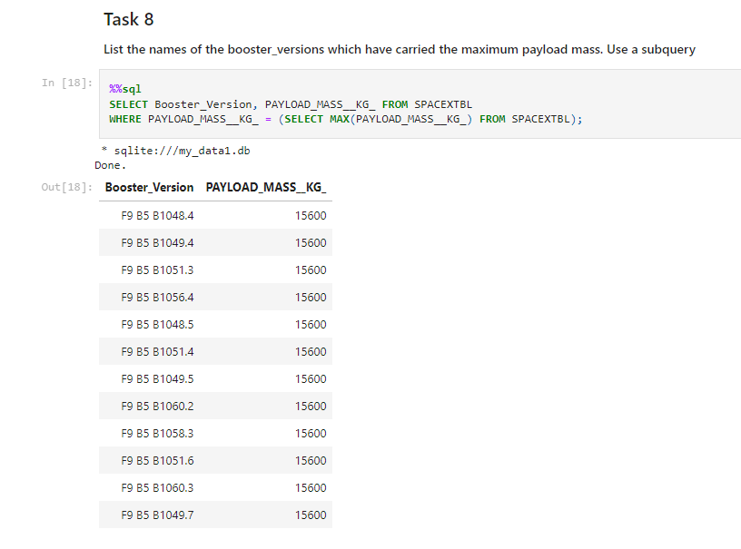
Boosters Carried Maximum Payload
The maximum payload mass is 15600 Kg.
Beside are the boosters who carried it.

Slide 33
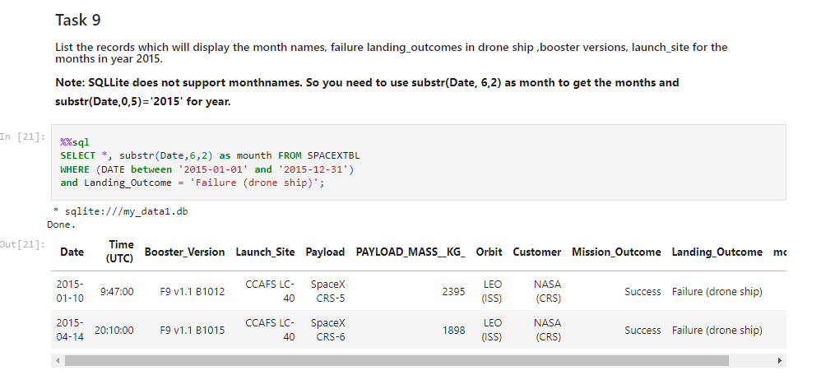
2015 Launch Records
There are two missiong who’s drone ship landing failed in 2015.
Substr() function was used to display month as column.

Slide 34
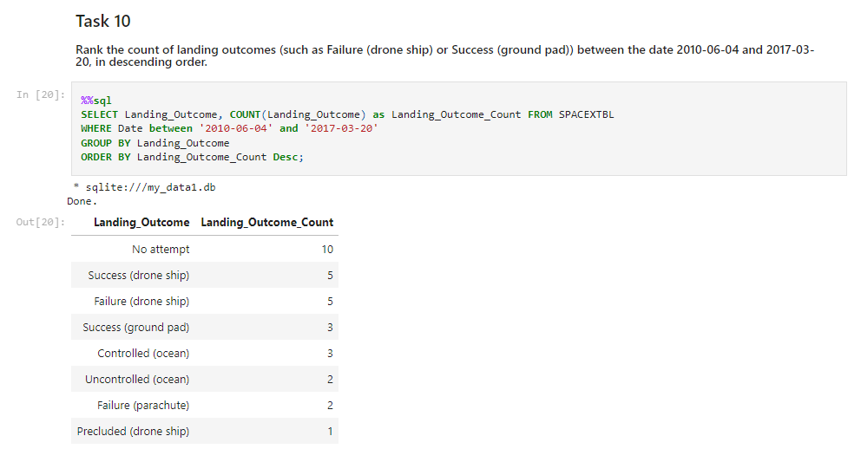
Rank Landing Outcomes Between 2010-06-04 and 2017-03-20
The landing outcomes was calculated using count().
We get the descending order using Desc.

Slide 35

Section 3

Slide 36
<Folium Map Screenshot 1>
Replace <Folium map screenshot 1> title with an appropriate title
Explore the generated folium map and make a proper screenshot to include all launch sites’ location markers on a global map
Explain the important elements and findings on the screenshot

Slide 37
<Folium Map Screenshot 2>
Replace <Folium map screenshot 2> title with an appropriate title
Explore the folium map and make a proper screenshot to show the color-labeled launch outcomes on the map
Explain the important elements and findings on the screenshot

Slide 38
<Folium Map Screenshot 3>
Replace <Folium map screenshot 3> title with an appropriate title
Explore the generated folium map and show the screenshot of a selected launch site to its proximities such as railway, highway, coastline, with distance calculated and displayed
Explain the important elements and findings on the screenshot

Slide 39

Section 4

Slide 40
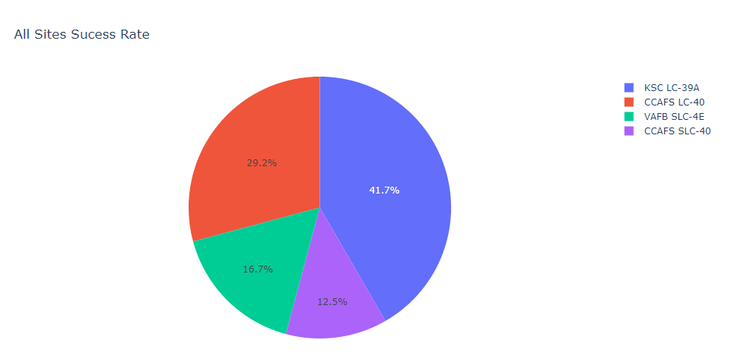
All Sites Success Rate
KSC site had the highest success rate with almost 42% of aver all successful landing, followed by CCAFS LC-40.
VAFB got the lowest success rate.

Slide 41
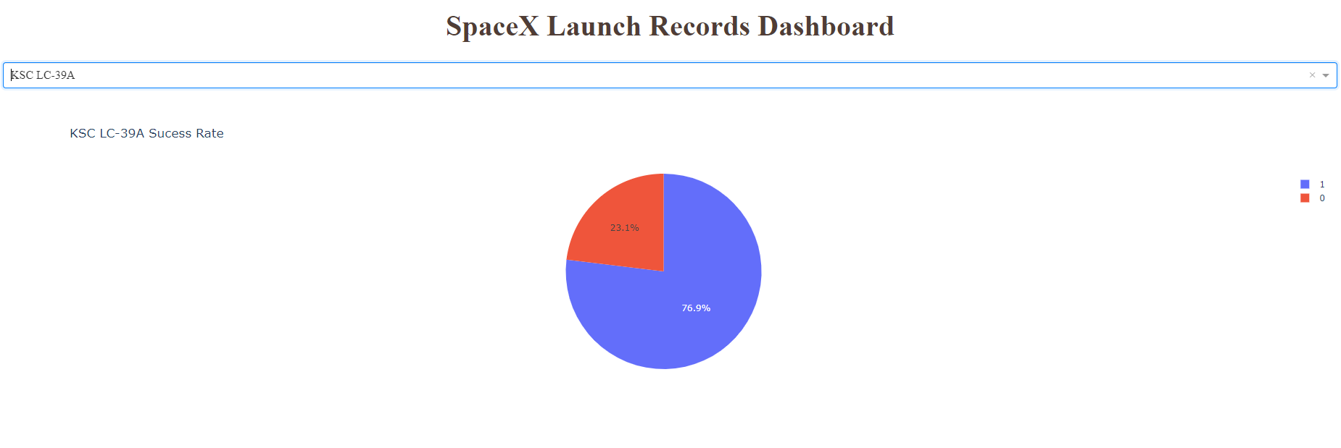
KSC LC-39A Success Rate
77% of rockets launched from KSC LC-39A got a successful landing outcome.

Slide 42
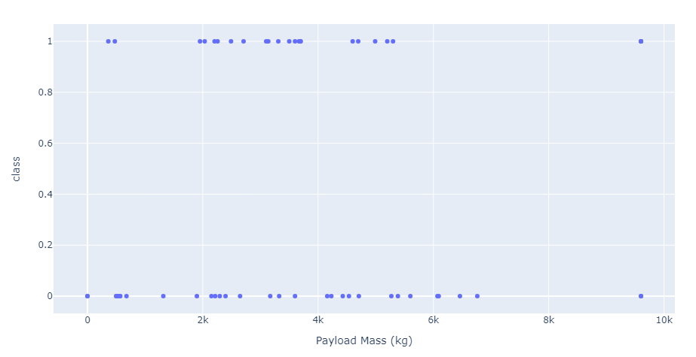
Full Payload range scatter plot
Success is higher for payload mass between 2000 and 4000 kg

Slide 43

Section 5

Slide 44
Classification Accuracy
Visualize the built model accuracy for all built classification models, in a bar chart
Find which model has the highest classification accuracy

Slide 45
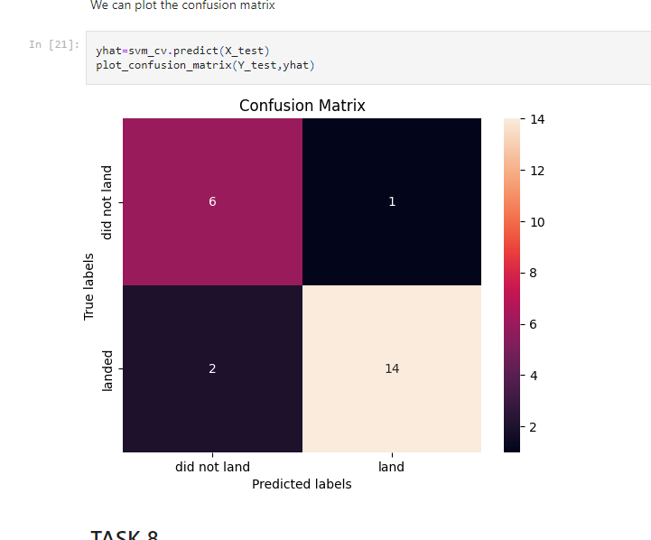
Confusion Matrix
Support vector machine gave the best accuracy. Because it minimized false positive.

Slide 46
Conclusions
Point 1
Point 2
Point 3
Point 4
…

Slide 47
Appendix
All Notebook projects are available on my github repository:
https://github.com/Alma-Soul/Coursera.git

Slide 48


